Slide 1

EASTERN INTERNATIONAL UNIVERSITY
SCHOOL OF COMPUTING AND INFORMATION TECHNOLOGY
DEPARTMENT OF SOFTWARE ENGINEERING
ELA ENGLISH LANGUAGE CENTER MANAGEMENT
Students
Nguyen Gia Bao - 1831200023
Supervisor
Tat Quang Phat, M.Sc.

Slide 2
TABLE OF CONTENTS
I. INTRODUCTION
II. TECHNOLOGIES
III.SUBJECT ANALYSIS
IV. CONCLUSION AND FUTURE WORKS

Slide 3

INTRODUCTION
MOTIVATION
In Viet Nam, the number of English centers has grown rapidly over the last 10 years.
However, the digitization of the management process of language centers is yet to be applied widely.

Slide 4
INTRODUCTION
OBJECTIVES
Help to simplify the management process of these centers
Create a way of interaction between students and English centers outside of study time

Slide 5



TECHNOLOGIES
Java
Android studio
Firebase

Slide 6
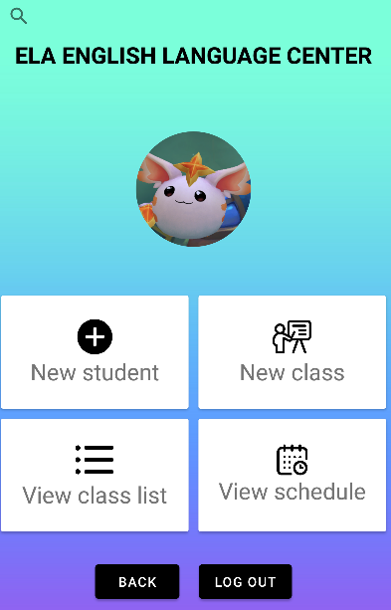
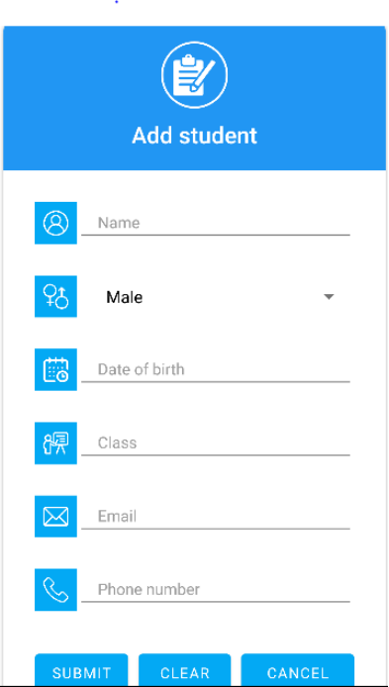
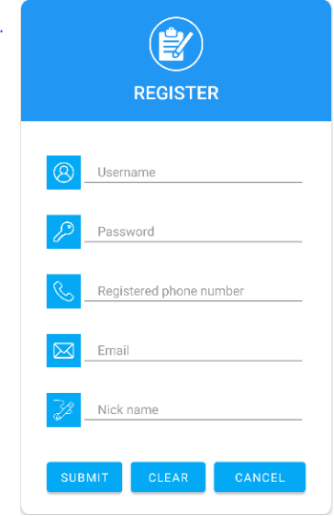
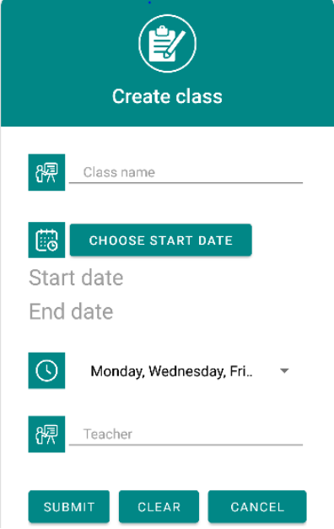
FEATURES
Make new account
Retrieve password
Add new student
View student profile
Create new class
View class information
Search for student or class

Slide 7
CONCLUSION AND FUTURE WORKS
RESULTS
Created multiple working functions for staff users.
Applied Firebase to manage database.
Quite good looking UI

Slide 8
CONCLUSION AND FUTURE WORKS
DRAWBACKS
Some functions are not yet finished.
Not fully apply any main design pattern.
UI of the app is still too simple.
Lack of notification interfaces.

Slide 9
CONCLUSION AND FUTURE WORKS
FUTUREWORKS
Finish all function for staff users.
Add more notification interfaces.
Develop interfaces for normal users.
Work on security.
Apply design pattern.

Slide 10


